Slide 1

Elizabethan Theatre

Slide 2
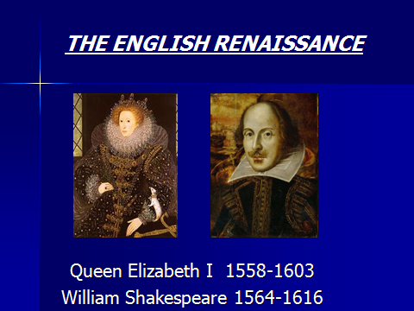

Slide 3
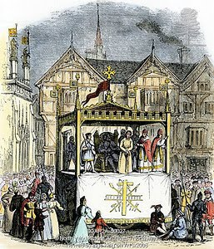
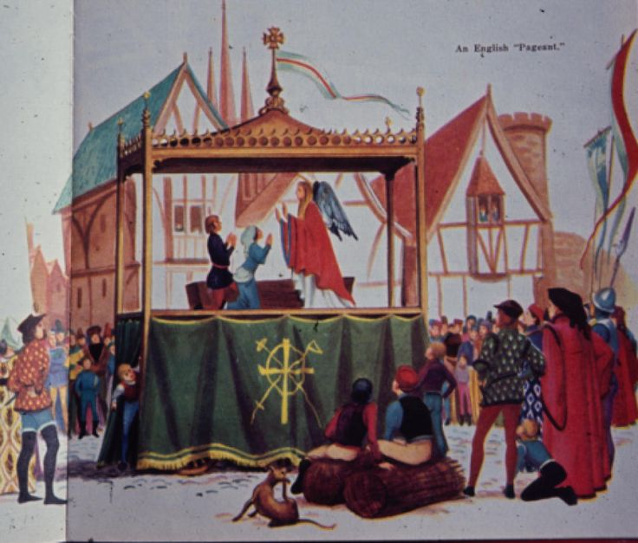
Mediaeval mystery and miracle plays

Slide 4
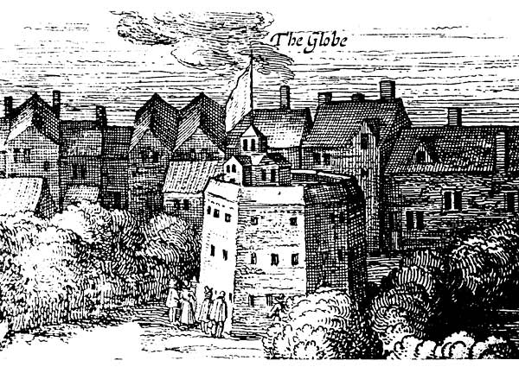

Slide 5
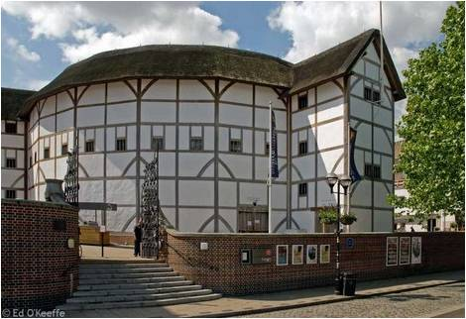

Slide 6
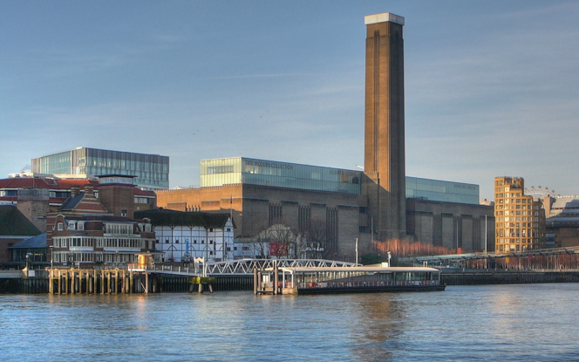

Slide 7
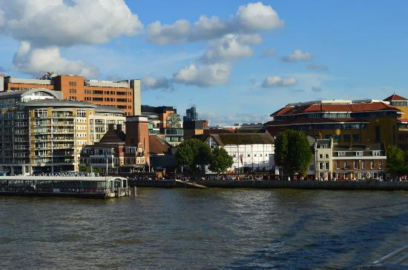

Slide 8
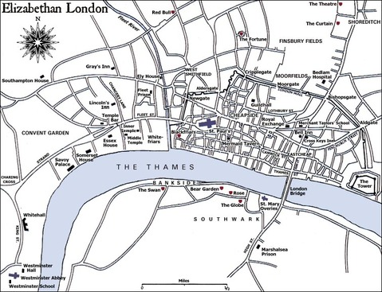

Slide 9
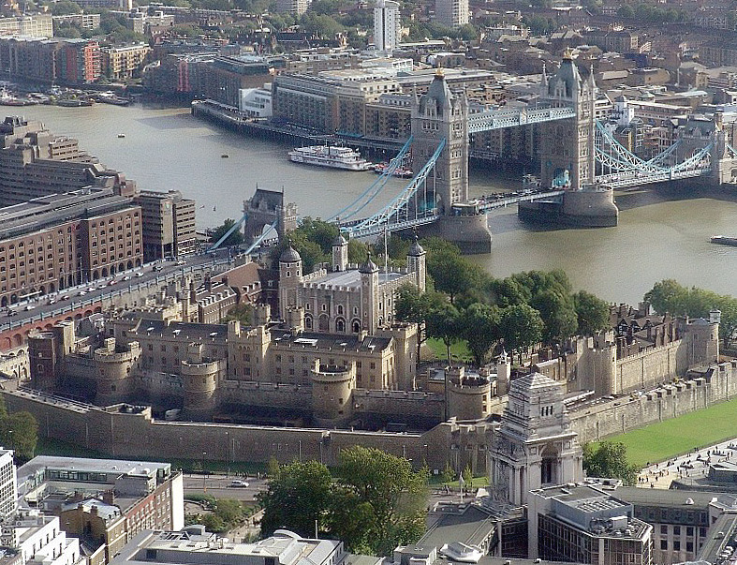

Slide 10
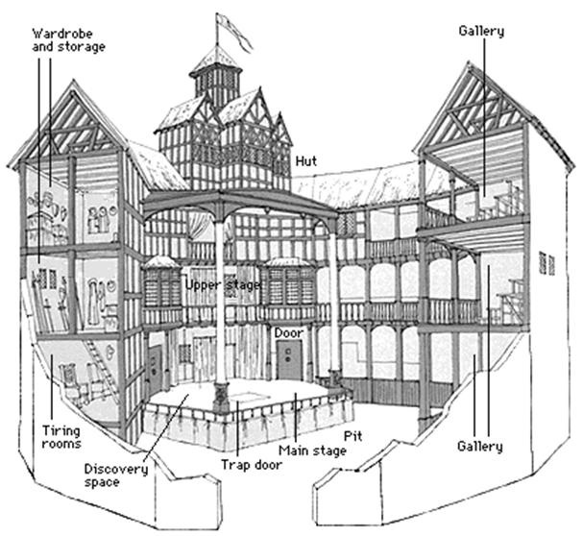

Slide 11
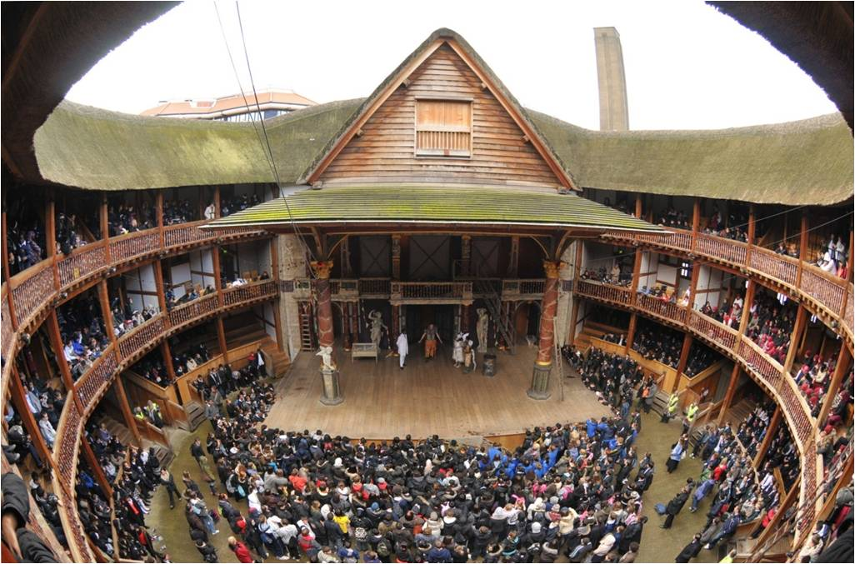

Slide 12
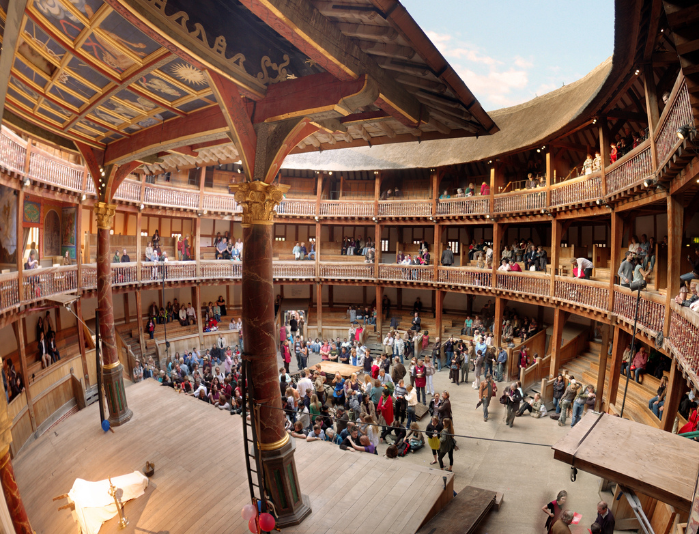

Slide 13
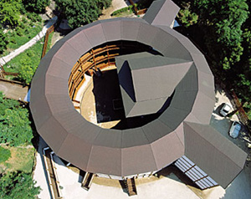

Slide 14
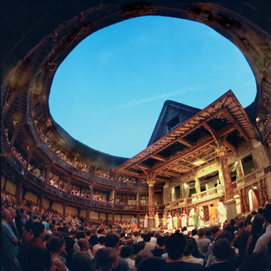

Slide 15
No females on the stage
Young boys in the roles of women
Very few props on the stage
Central role of language
Special relationship between actors and audiences

Slide 16
In Shakespeare's words
All the world's a stage,
And all the men and women merely players.
(As You Like It)
Within this wooden O. (Henry V)
Life's but a walking shadow; a poor player,
That struts and frets his hour upon the stage,
And then is heard no more. (Macbeth)

